Slide 1
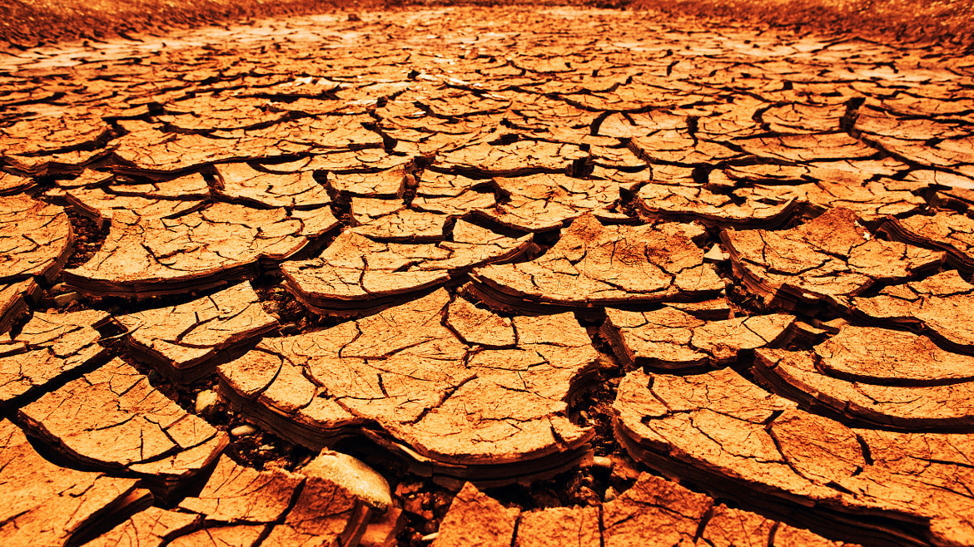
August 8, 2021
Thirsting for God
Psalm 63

Slide 2
Psalm 63
A Psalm of David, when he was in the wilderness of Judah.
1 O God, You are my God; I shall seek You earnestly; My soul thirsts for You, my flesh yearns for You, In a dry and weary land where there is no water. 2 Thus I have seen You in the sanctuary, To see Your power and Your glory. 3 Because Your lovingkindness is better than life, My lips will praise You. 4 So I will bless You as long as I live; I will lift up my hands in Your name. 5 My soul is satisfied as with marrow and fatness, And my mouth offers praises with joyful lips. 6 When I remember You on my bed, I meditate on You in the night watches, 7 For You have been my help, And in the shadow of Your wings I sing for joy. 8 My soul clings to You; Your right hand upholds me. 9 But those who seek my life to destroy it, Will go into the depths of the earth. 10 They will be delivered over to the power of the sword; They will be a prey for foxes. 11 But the king will rejoice in God; Everyone who swears by Him will glory, For the mouths of those who speak lies will be stopped.

Slide 3
Big Idea
Believers are to have and develop a passion for God by seeking Him always, regardless of the circumstances

Slide 4
Believers are to have a passion for God ⁽¹⁻²⁾
1 O God, You are my God; I shall seek You earnestly; My soul thirsts for You, my flesh yearns for You, In a dry and weary land where there is no water. 2 Thus I have seen You in the sanctuary, To see Your power and Your glory.
David knows God personally (1a)
David knows god passionately (1b-2)

Slide 5
Believers are to express praise to God ⁽³⁻⁵⁾
3 Because Your lovingkindness is better than life, My lips will praise You. 4 So I will bless You as long as I live; I will lift up my hands in Your name. 5 My soul is satisfied as with marrow and fatness, And my mouth offers praises with joyful lips.
David’s declaration (3a)
David’s determination (3b-5)

Slide 6
Believers are to be in pursuit of God ⁽⁶⁻⁸⁾
6 When I remember You on my bed, I meditate on You in the night watches, 7 For You have been my help, And in the shadow of Your wings I sing for joy. 8 My soul clings to You; Your right hand upholds me.
David contemplates God (6)
David celebrates God (7)
David clings to God (8)

Slide 7
Believers receive protection from God (9-11)
9 But those who seek my life to destroy it, Will go into the depths of the earth. 10 They will be delivered over to the power of the sword; They will be a prey for foxes. 11 But the king will rejoice in God; Everyone who swears by Him will glory, For the mouths of those who speak lies will be stopped.
David looked to God for victory (9-10)
David’s enemies were doomed (9)
David’s enemies will be defeated (10a)
David’s enemies will be devoured (10b)
David looked to God for vindication (11)

Slide 8
August 8, 2021
Thirsting for God
Psalm 63

